Slide 1
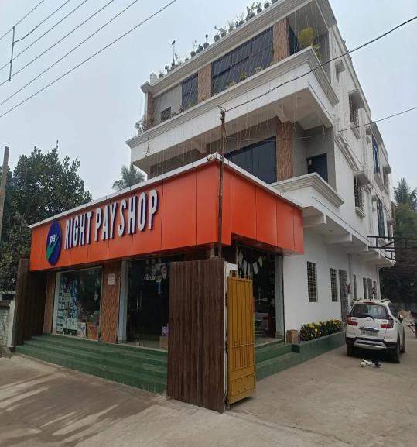



COMPANY PROFILE · 2026
SHOP RIGHTEPAY
CORPORATION LIMITED
Retail & Wholesale Trading House
A West Bengal-based public limited commercial enterprise—which supplies groceries, FMCG products, apparel, footwear, and daily essentials to Durgapur and its neighboring markets through modern multi-category retail channels—is set to launch an online grocery delivery service via a dedicated mobile app in 2026.
CIN U45400WB2011PLC161876
Gopalpur, Durgapur · 713212
+91 98753 69532
rightpayshop.com

Slide 2
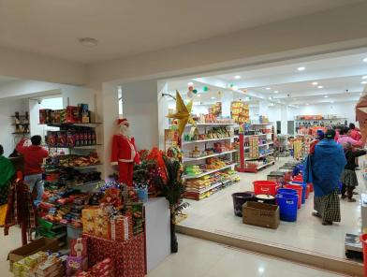
01 · WHO WE ARE
Company at a Glance
A registered public limited company operating a modern multi-category retail and wholesale trading house in Gopalpur, Durgapur. The business is built on three foundations: a wide assortment under one roof, transparent pricing, and a clean, well-lit shopping environment that customers in tier-2 markets rarely experience.
2011
Durgapur
₹1.87 Cr
5+
Year of Incorporation
Operational Location
Paid-up Capital
Product Categories
Inside the Right Pay Shop floor — Durgapur
Multi-aisle layout with packaged foods, personal care, household goods, festive merchandise, and seasonal categories under one roof.
SHOP RIGHTEPAY CORPORATION LIMITED | Retail & Wholesale Trading House | Gopalpur, Durgapur, West Bengal
02

Slide 3



02 · PURPOSE
Vision, Mission & Values
Vision
Mission
Values
To be the most trusted multi-category retail destination in the Durgapur–Asansol industrial belt, where families and businesses can fulfil their daily and bulk needs in a single, well-organised visit.
Deliver consistent quality, fair pricing, and a respectful in-store experience by combining direct sourcing, disciplined inventory practices, and locally rooted customer service.
Transparency in pricing, integrity in dealings, dignity in service, and reinvestment in the local community we operate within. Every transaction is treated as a long-term relationship.
SHOP RIGHTEPAY CORPORATION LIMITED | Retail & Wholesale Trading House | Gopalpur, Durgapur, West Bengal
03

Slide 4

03 · CORPORATE IDENTITY
Legal & Statutory Snapshot
Legal Name
SHOP RIGHTEPAY CORPORATION LIMITED
CIN
U45400WB2011PLC161876
KEY REGISTRATIONS
PAN
AAECT3123G
GSTIN
19AAECT3123G1ZI
MCA Incorporation
Companies Act, 1956 — RoC Kolkata
Date of Incorporation
20 April 2011
PAN — Income Tax
Class of Company
Public, limited by shares
AAECT3123G (e-PAN)
Registrar of Companies
RoC – Kolkata
GST — West Bengal
Authorised Capital
₹5,00,00,000
19AAECT3123G1ZI · Regular taxpayer
Paid-up Capital
₹1,87,00,000
Udyam (MSME)
Company Status
Active · ACTIVE Compliant
UDYAM-WB-18-0002126 · Micro Enterprise
Name Change (2020)
From Trio Land & Projects Dev. Ltd.
SHOP RIGHTEPAY CORPORATION LIMITED | Retail & Wholesale Trading House | Gopalpur, Durgapur, West Bengal
04

Slide 5

04 · LEADERSHIP
Board of Directors
The company is governed by a three-member board combining promoter ownership with independent professional oversight, ensuring continuity, accountability, and balanced decision-making.
BG
RC
JS
Braja Gopal Chatterjee
Rupa Chatterjee
Joy Sinha
Director · Promoter
Director · Promoter
Director · Professional
DIN 03276552 · Appointed 20 Feb 2020
DIN 06679539 · Appointed 10 Mar 2020
DIN 10753751 · Appointed 29 Aug 2025
Co-founder; oversees overall business strategy, vendor relationships, and store operations.
Co-founder; leads administration, statutory compliance, and financial governance.
Independent professional director contributing governance and strategic guidance.
SHOP RIGHTEPAY CORPORATION LIMITED | Retail & Wholesale Trading House | Gopalpur, Durgapur, West Bengal
05

Slide 6




05 · WHERE WE OPERATE
Registered Office & Store Location
REGISTERED OFFICE
First Floor, Village & PO Gopalpur,
PS Kanksa, Gopalpur, Bardhaman,
West Bengal — 713212 · India
Jurisdictional GST Office: Baruipur
RETAIL STORE · RIGHT PAY SHOP
Netaji Street, Uttarpara, Gopalpur,
Durgapur, West Bengal — 713212
+91 98753 69532
support@rightpayshop.com
rightpayshop.com
SHOP RIGHTEPAY CORPORATION LIMITED | Retail & Wholesale Trading House | Gopalpur, Durgapur, West Bengal
06

Slide 7






06 · WHAT WE DO
Business Activities
Under our Udyam (MSME) registration, the company is mapped to a comprehensive set of National Industry Classification (NIC) codes spanning trading, retail, and select manufacturing — with retail trading as the principal activity.
Groceries & Food
Apparel
Footwear & Leather
Cereals, pulses, tea, coffee, spices, flour and packaged staples — sold in retail and small-bulk packs.
Readymade garments, hosiery, and clothing accessories for men, women, and children.
Branded and unbranded footwear, leather goods, and travel accessories.
Household Goods
Wholesale Trading
Light Manufacturing
Furniture, utensils, crockery, glassware, gas stoves, refrigerators, washing machines and other appliances.
Non-specialised wholesale supply to local kirana and institutional buyers across the Durgapur belt.
Spice grinding & processing, fabricated metal products, and bamboo/reed storage articles — registered under NIC.
SHOP RIGHTEPAY CORPORATION LIMITED | Retail & Wholesale Trading House | Gopalpur, Durgapur, West Bengal
07

Slide 8
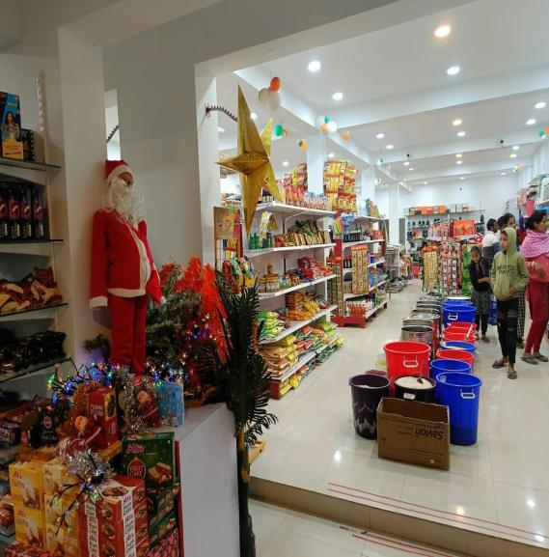
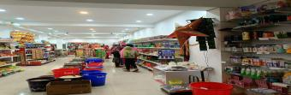
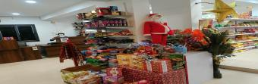
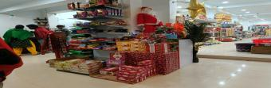
07 · THE FLOOR
Inside the Right Pay Shop Experience
Grocery aisle · personal care wall
Christmas & festive merchandising
Festive aisle with FMCG, snacks, and household staples
A bright, well-lit shopping floor with clearly marked categories and pricing.
Bakery & confectionery counter
SHOP RIGHTEPAY CORPORATION LIMITED | Retail & Wholesale Trading House | Gopalpur, Durgapur, West Bengal
08

Slide 9
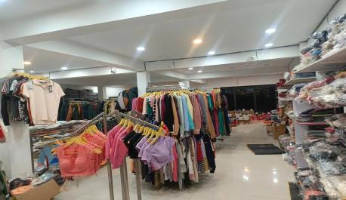
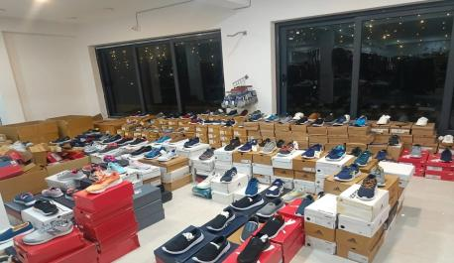
08 · BEYOND GROCERY
Apparel, Footwear & Lifestyle
The Durgapur store is not a one-category outlet. Dedicated zones for clothing and footwear give customers a department-store feel within a single visit — a rare offering at this price-point in the local market.
APPAREL ZONE
FOOTWEAR ZONE
Men, women & kids — readymade garments, hosiery, accessories.
Sports, casual & formal — leading brands and value picks.
SHOP RIGHTEPAY CORPORATION LIMITED | Retail & Wholesale Trading House | Gopalpur, Durgapur, West Bengal
09

Slide 10





09 · OUR ADVANTAGE
Why Customers Choose Us
Wide Assortment
Fair, Transparent Pricing
Trust & Compliance
Groceries, FMCG, apparel, footwear, household goods and seasonal merchandise — under one roof.
Clear MRP-based pricing across categories, with regular value packs and seasonal offers.
Public limited company structure with CIN, GST, PAN, and Udyam registrations — fully compliant operations.
Convenience
Local Roots
Quality Discipline
A spacious, well-lit floor with organised aisles and helpful staff that respects every customer’s time.
Run by a Durgapur-based promoter family — sourcing, hiring, and reinvesting locally.
Consistent quality checks at intake, with clear rotation of perishables and packaged stock.
Pay Right, Get Right — at Rightepay.
Our brand promise to every customer who walks through the doors.
SHOP RIGHTEPAY CORPORATION LIMITED | Retail & Wholesale Trading House | Gopalpur, Durgapur, West Bengal
10

Slide 11
PART TWO
From the
Neighbourhood
to the App.
Introducing Rightepay Express — our quick-commerce vertical built on a proprietary technology stack and powered by a Franchise-Owned, Franchise-Operated (FOFO) network across West Bengal.
SHOP RIGHTEPAY CORPORATION LIMITED | Retail & Wholesale Trading House | Gopalpur, Durgapur, West Bengal
11

Slide 12

11 · THE NEXT CHAPTER
Rightepay Express — Quick Commerce
Building on a successful brick-and-mortar retail footprint in Durgapur, the company is now operationalising a hyperlocal home-delivery business under its own brand — competing in the same category as Blinkit, Apna Mart, and Ekart, but built specifically for Tier-2 and Tier-3 West Bengal where these national players do not yet have meaningful presence.
Express Delivery
Owned Technology
FOFO Expansion
Express slots from 10 minutes; full-basket delivery within a 6-km radius of every store.
A proprietary customer app, admin console, and rider-tracking app — built and operated entirely in-house.
Franchise-Owned, Franchise-Operated network — capital-efficient growth with full operational support.
BUILT FOR WEST BENGAL · WHERE BLINKIT & ZEPTO DON'T YET DELIVER · ON OUR OWN TECHNOLOGY
SHOP RIGHTEPAY CORPORATION LIMITED | Retail & Wholesale Trading House | Gopalpur, Durgapur, West Bengal
12

Slide 13



12 · THE OPPORTUNITY
Why Quick Commerce, Why Now
₹35,000 Cr+
23 Districts
Local Roots
Indian Quick Commerce GMV by 2027*
in West Bengal underserved by 10-min apps
with retail credibility since 2011
A Category in Hyper-Growth
An Underserved Geography
An Established Operator
Quick commerce is the fastest-growing retail format in India. Yet the entire footprint sits across roughly 25 metro districts — a fraction of the country.
Outside Kolkata's prime pincodes, Tier-2 and Tier-3 towns across West Bengal — Durgapur, Asansol, Bardhaman, Kharagpur, Siliguri — have rising disposable income but no native quick-commerce brand.
Most new entrants are starting from zero. We arrive with a fifteen-year corporate history, an active store, established vendor relationships, and the physical infrastructure to host hyperlocal hubs from day one.
*Industry estimates from leading research houses (Redseer, Bain, RBSA Advisors). Indicative; not company forecast.
SHOP RIGHTEPAY CORPORATION LIMITED | Retail & Wholesale Trading House | Gopalpur, Durgapur, West Bengal
13

Slide 14



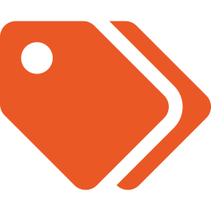

13 · THE PROMISE
Service Standards Customers Can Count On
10 min
Express Delivery Window
THE 6 KM CIRCLE
Standard slot for the full basket — packaged staples, FMCG, fresh produce, personal care and household goods.
6 km
Hyperlocal Reach Per Store
3 km · core zone
Every Rightepay store anchors a service circle of 6 km, mapped to optimised rider routes for predictable arrival times.
MRP
Transparent Pricing
No surge pricing, no hidden fees on essentials. Where MRP applies, customers pay MRP — and benefit from regular branded offers.
STORE
24×7
Each store anchors a defined hyperlocal zone. Districts are filled by a network of stores — never by long-haul logistics from a single hub.
Customer Support
In-app chat, WhatsApp, and a dedicated support line — all monitored by a Bengali-fluent support team during peak hours.
SHOP RIGHTEPAY CORPORATION LIMITED | Retail & Wholesale Trading House | Gopalpur, Durgapur, West Bengal
14

Slide 15

14 · THE PLATFORM
Proprietary Technology — Built In-House
Unlike most regional operators who lease white-label storefronts, Rightepay Express runs on a fully owned three-app stack — designed, developed, and maintained by an in-house engineering team. This gives us cost control, road-map ownership, and the freedom to localise rapidly.
FOR CUSTOMERS
FOR THE BUSINESS
FOR DELIVERY
Customer App
Admin Console
Rider Tracking App
Catalogue, search, and 'Shop by Category'
Express slot booking · 10 min default
Self-billing checkout & UPI / wallet payments
Live order tracking with rider ETA
Cookbook, flash offers, hot deals
Multi-store catalogue & pricing engine
Real-time inventory & order management
Sales analytics, dashboards, and reports
Promotions, banners, and flash offers
Franchise login per store · siloed data
Order assignment with route optimisation
Live GPS, pickup & drop confirmations
Rider performance & earnings view
Push notifications for new orders
Offline queue for low-signal areas
SHOP RIGHTEPAY CORPORATION LIMITED | Retail & Wholesale Trading House | Gopalpur, Durgapur, West Bengal
15

Slide 16
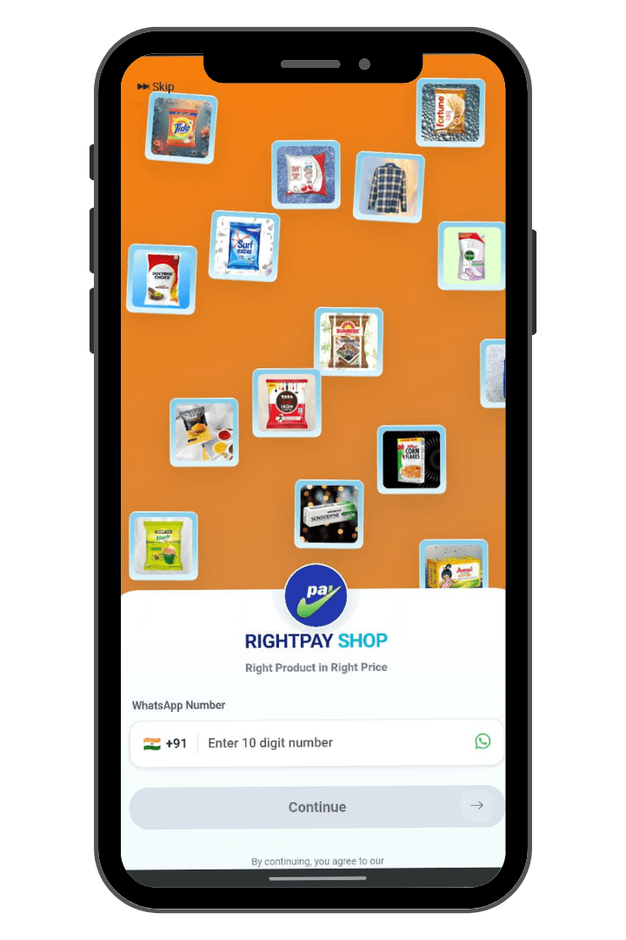
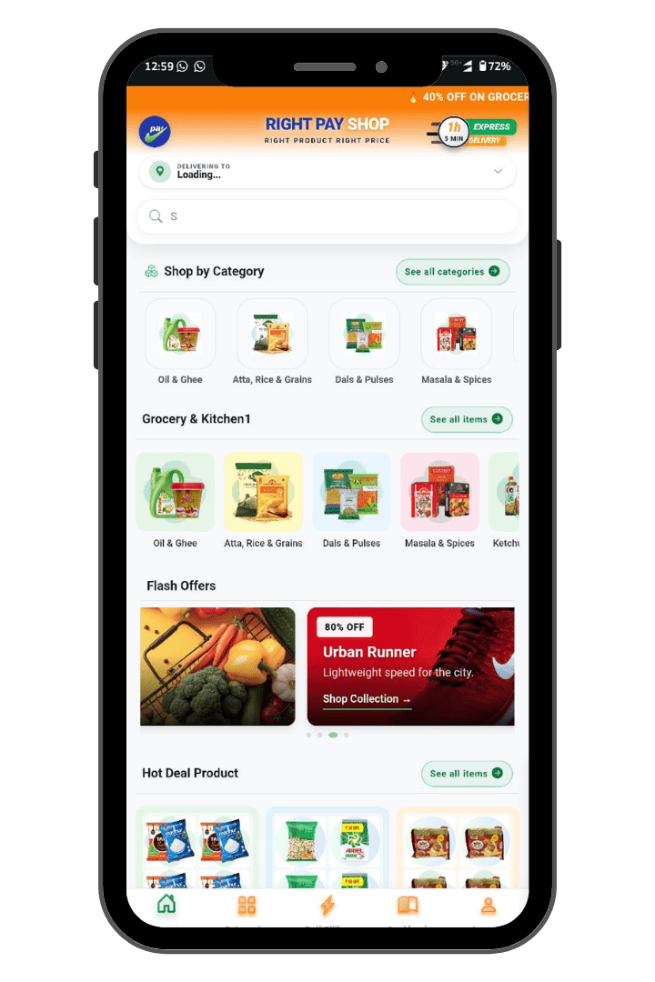





15 · PRODUCT WALKTHROUGH
Customer App — Live Screens
Two screens from the live build show the brand identity and category-led shopping experience that customers see today.
ONBOARDING
HOME · CATEGORIES · OFFERS
WHAT YOU SEE ON-SCREEN
Express Delivery Banner
Persistent ’10 min’ promise & 40 % grocery offer banner.
Universal Search
Type-ahead search across the full catalogue.
Shop by Category
Oil & Ghee, Atta, Dals, Masala — clear visual entry points.
Flash Offers Carousel
Time-bound deep discounts on rotating categories.
Self-Billing
Walk-in customers can scan & pay via the same app.
Account & Tracking
Orders, addresses, support, rewards — one tap away.
SHOP RIGHTEPAY CORPORATION LIMITED | Retail & Wholesale Trading House | Gopalpur, Durgapur, West Bengal
16

Slide 17






16 · THE FOUNDATIONS
Business & Technology Credentials
The backbone behind the brand: legal identity, developer infrastructure, and the people who keep the platform running.
In-House IT Team
Google Play Console
DUNS Number
A dedicated engineering and design team responsible for the entire stack — no third-party dependency for the core platform.
An active developer account with full rights to publish, update, and manage the customer and rider apps on the Play Store.
A globally recognised D-U-N-S identifier — required for Apple App Store enrolment, banking, and enterprise procurement.
Cloud-Native Architecture
Security & Compliance
Continuous Delivery
Deployed on enterprise cloud with auto-scaling, daily backups, encrypted databases, and clear separation of staging and production.
HTTPS everywhere, payment gateway integration via PCI-DSS-compliant partners, role-based access in the admin console.
Versioned releases of the customer, rider, and admin builds — bug-fix turnarounds measured in days, not quarters.
SHOP RIGHTEPAY CORPORATION LIMITED | Retail & Wholesale Trading House | Gopalpur, Durgapur, West Bengal
17

Slide 18



17 · OPERATING MODEL
Hyperlocal Hub Network
Every Rightepay Express order is fulfilled from the nearest store-cum-hub. Inventory sits within 6 km of the customer at all times — there is no central warehouse-to-customer leg, no broken cold chain, and no last-mile from another city.
1. Order Placed
2. Hub Receives
3. Picked & Packed
4. Rider Dispatched
5. Delivered
Customer places order on the app — average basket < 60 seconds.
Nearest hub auto-receives & confirms. Picking starts within 30 seconds.
Trained packers fulfill from organised micro-aisles inside the store.
Order assigned to nearest rider; route optimised in real time.
Customer receives within slot. Rider closes loop in the rider app.
< 60s
< 30s
< 8m
< 65m
BASKET BUILD
PICK START
PACK COMPLETE
DOORSTEP
SHOP RIGHTEPAY CORPORATION LIMITED | Retail & Wholesale Trading House | Gopalpur, Durgapur, West Bengal
18

Slide 19

18 · THE EXPANSION ENGINE
Franchise Model — FOFO
Rightepay Express expands across West Bengal through a Franchise-Owned, Franchise-Operated (FOFO) model. The franchisee owns the store and runs day-to-day operations within our standards; the company provides the brand, the technology platform, supply, training, and growth support.
WHAT THE COMPANY PROVIDES
WHAT THE FRANCHISEE BRINGS
Right Pay Shop brand, signage, and identity
Approved retail space (500 – 10,000 sq. ft.)
Customer, admin, and rider apps · zero IT burden
Franchise fee, fit-out, and opening inventory cost
Site survey, layout design, and store launch support
Day-to-day store operations and on-floor staffing
Centralised supply with negotiated brand pricing
Local cash handling and basic working capital
Marketing campaigns, banners, and seasonal offers
Adherence to brand standards and SOPs
Staff training, SOP manuals, and operational playbooks
Local market relationships & community engagement
Technology updates & 24×7 platform support
Royalty as per agreed structure (see next slide)
SHOP RIGHTEPAY CORPORATION LIMITED | Retail & Wholesale Trading House | Gopalpur, Durgapur, West Bengal
19

Slide 20
19 · THE NUMBERS
Investment Profile & Indicative Returns
Indicative ranges only — actual figures depend on store size, location, and market conditions, and are confirmed during the franchise discussion. Aligned to industry benchmarks for Smart Market FOFO formats.
500 – 10,000
₹3,00,000
₹15 – 25 L
18 – 24
sq. ft.
+ GST
indicative
months
Store Footprint Range
Franchise Fee
Total Project Cost*
Indicative Payback Window
INDICATIVE MONTHLY EARNINGS — SMART MARKET FOFO BANDS
Tier | Store Size | Indicative Monthly Sales | Net Margin Band | Indicative Owner Take-Home
Compact | 500 – 1,500 sq. ft. | ₹10 – 15 lakh | 8 – 12 % | ≈ ₹1,00,000 / month
Standard | 1,500 – 4,000 sq. ft. | ₹25 – 35 lakh | 9 – 13 % | ≈ ₹3,00,000 / month
Flagship | 4,000 – 10,000 sq. ft. | ₹40 – 60 lakh | 10 – 14 % | ≈ ₹4,00,000 / month
* Total project cost includes franchise fee, fit-out, fixtures, opening inventory, and working capital. All figures indicative and subject to written agreement. Royalty: 3 % of monthly sales or ₹25,000 (whichever is higher) where the company provides the store manager — alternatively, ₹10 / sq. ft. on total store area.
SHOP RIGHTEPAY CORPORATION LIMITED | Retail & Wholesale Trading House | Gopalpur, Durgapur, West Bengal
20

Slide 21



20 · THE SUPPORT PACKAGE
Everything Franchisees Receive on Day One
A franchise is more than a brand licence. Every Rightepay Express partner gets the full operating system — from the day the agreement is signed to the day the store opens, and every month thereafter.
Brand & Identity
Site & Fit-Out
Opening Inventory
Technology Stack
Right Pay Shop signage, uniforms, packaging, point-of-sale collateral.
Site evaluation, layout design, fixture specs, vendor coordination for setup.
Curated launch SKU mix tuned to local taste — pre-negotiated brand pricing.
Customer app, admin console, and rider app — pre-configured for the store.
Training
Marketing Launch
Operational Support
Performance Reviews
Two-week residential & on-site training for owner, manager, packers, and riders.
Pre-launch buzz, opening offers, first-month digital campaign in the local zone.
Dedicated franchise success manager · 24×7 platform & supply helpdesk.
Monthly P&L review, category mix advice, demand forecasts and re-order plans.
SHOP RIGHTEPAY CORPORATION LIMITED | Retail & Wholesale Trading House | Gopalpur, Durgapur, West Bengal
21

Slide 22
21 · HOW IT WORKS
From First Conversation to Store Opening
A clear, predictable path from enquiry to opening day — typically 60 to 90 days, depending on site readiness.
Step 1 · Enquiry & Discovery
Week 1
Franchisee submits interest. Our team shares brochure, model summary, and indicative numbers. A discovery call follows.
Step 2 · Site & Catchment Review
Week 1–2
Joint visit to the proposed site. Catchment study, footfall estimate, and 6-km service zone analysis.
Step 3 · Agreement & Onboarding
Week 3
Franchise agreement signed. Fee paid. Owner and manager begin Right Pay Shop training programme.
Step 4 · Fit-Out & Tech Setup
Week 4–8
Layout finalised, fixtures installed, network and POS systems deployed, inventory ordered.
Step 5 · Soft Launch & Go-Live
Week 9–12
Soft launch with neighbourhood preview, then full marketing-backed grand opening with launch offers.
SHOP RIGHTEPAY CORPORATION LIMITED | Retail & Wholesale Trading House | Gopalpur, Durgapur, West Bengal
22

Slide 23
22 · THE ROADMAP
West Bengal Expansion Plan
A staged rollout across West Bengal — anchored in Durgapur, expanded through the industrial belt, and ultimately reaching every district town.
PHASE 1
PHASE 2
PHASE 3
2026 · Year One
2027 · Year Two
2028+ · Statewide
Anchor & Prove
Industrial Belt
Full Coverage
5 stores
20 stores
50+ stores
Network target
Network target
Network target
KEY GEOGRAPHIES
KEY GEOGRAPHIES
KEY GEOGRAPHIES
Durgapur (flagship)
Asansol
Bardhaman town
Raniganj
Andal
Durgapur–Asansol corridor
Howrah & Hooghly
Bankura
Purulia
Birbhum (Bolpur, Suri)
North Bengal (Siliguri, Jalpaiguri)
South Bengal (Kharagpur, Midnapore)
Murshidabad, Malda
24-Parganas (excl. metro Kolkata)
Cooch Behar, Alipurduar
Establish unit economics, refine SOPs, build the regional vendor network, validate the technology stack at scale.
Open the FOFO pipeline. Densify the western industrial belt and begin entry into adjacent districts.
Statewide footprint with city clusters of multiple hubs. Brand becomes the default quick-commerce option outside Kolkata.
SHOP RIGHTEPAY CORPORATION LIMITED | Retail & Wholesale Trading House | Gopalpur, Durgapur, West Bengal
23

Slide 24




23 · THE PARTNERSHIP CASE
Why Partner With Rightepay
A Compliant Public Limited Brand
Owned, Updated Technology
Retail Operator, Not Just a Brand
Backed by an active, RoC-compliant public limited company with valid GST, PAN, and Udyam credentials — not a private re-seller.
You don't lease a third-party storefront. The platform is ours — and so are the road-map, the bug-fixes, and the upgrades.
We run the flagship store ourselves. Every SOP we hand you has been pressure-tested on our own floor in Durgapur.
Local Execution Advantage
Speed to Market
Aligned Incentives
Bengali-speaking support, regional vendor relationships, and a leadership team that lives in West Bengal — not on a Zoom call from Delhi.
Site to opening day in 60–90 days. Pre-negotiated supplier contracts and ready-to-deploy systems compress the launch curve.
Our royalty is success-linked. We earn meaningfully only when the franchisee's store earns meaningfully — that keeps us focused on your P&L.
OWN THE BRAND IN YOUR TOWN. · APPLY TO BECOME A FRANCHISEE — DETAILS ON THE NEXT PAGE.
SHOP RIGHTEPAY CORPORATION LIMITED | Retail & Wholesale Trading House | Gopalpur, Durgapur, West Bengal
24

Slide 25
24 · OUR JOURNEY
Key Milestones
From a 2011 incorporation to a 2026 multi-category retail destination — built step by step on the foundations of compliance, governance, and customer trust.
2011
2020
2022
2023
2025
2026
Incorporated
Re-launched
GST Active
Retail Format
Board Expanded
Express Launch
Founded as Trio Land & Projects Development Ltd. in West Bengal.
Renamed to Shop Rightepay Corporation Limited; Chatterjee promoters take charge.
GST registration amended; classified as Regular taxpayer in West Bengal.
Right Pay Shop multi-category store operational at Gopalpur, Durgapur.
Joy Sinha appointed as professional director, strengthening governance.
Rightepay Express quick-commerce vertical launched; FOFO franchise rollout begins across West Bengal.
SHOP RIGHTEPAY CORPORATION LIMITED | Retail & Wholesale Trading House | Gopalpur, Durgapur, West Bengal
25

Slide 26
26 · Our Brand Partners
Our Brand Partners
We stock and sell products from India's most trusted FMCG, food, and consumer-goods companies — bringing national brand quality to our customers at fair, transparent prices.
ITC
HUL
Nestlé
Dabur
FMCG · Foods
Personal Care
Food & Beverages
Ayurveda · Foods
Britannia
Marico
Amul
Haldiram's
Bakery · Dairy
Oils · Personal Care
Dairy · Frozen
Snacks · Sweets
Mother Dairy
Patanjali
P&G
Colgate
Dairy · Frozen
Ayurveda · Foods
Personal & Home Care
Oral Care
Representative selection — full SKU and brand list available on request.
SHOP RIGHTEPAY CORPORATION LIMITED · Retail & Wholesale Trading House
CIN U45400WB2011PLC161876
08

Slide 27

OUR OWN BRAND
Our Own Brand — Launching 2026
30+ packaged daily-use products across the most essential grocery and dry-goods categories — direct sourcing, fair pricing, consistent quality.
Lentils & Pulses
8 SKUs
Whole & Ground Spices
12 SKUs
Masoor, Moong, Chana, Toor, Urad — split and whole
Single spices, blends, premium quality from origin
Sugar Range
3 SKUs
Nuts & Dry Fruits
7 SKUs
Refined, raw, and premium small-grain offerings
Cashew (W180/W240), almonds, raisins, mixed packs
Dhatri
Right Product · Right Price
DHATRI by SHOP RIGHTEPAY CORPORATION LIMITED · Launching 2026 · Trademark Filed Class 35
10

Slide 28


27 · Credentials Recognition
Credentials & Recognition
Our enterprise carries credentials that matter to institutional buyers, distributors, and partners — from a global business data registry to local customer-facing verification.
D&B D-U-N-S® REGISTERED
GOOGLE BUSINESS VERIFIED
Number 873809885
Right Pay Shop
Member of the Dun & Bradstreet Global Database — a globally recognised business credentialling system used by major corporations worldwide.
Listed and verified on Google — discoverable on Search and Maps, rated by real customers. Scan the QR for our public business profile.
SHOP RIGHTEPAY CORPORATION LIMITED · Retail & Wholesale Trading House
CIN U45400WB2011PLC161876
13

Slide 29
28 · Dhatri Product
Dhatri Product Range
A complete daily-essentials portfolio across four high-velocity categories — 30+ SKUs in total. All products are quality-checked, hygienically packed, and priced to win the kitchen.
LENTILS & PULSES
WHOLE & GROUND SPICES
SUGAR & SWEETENERS
NUTS & DRY FRUITS
Masoor Dal (Red Lentils)
Turmeric Powder
Refined Sugar
Cashews (W180)
Moong Dal (Yellow)
Red Chilli Powder
Raw Sugar
Cashews (W240)
Chana Dal
Coriander Powder
Premium Sugar
Almonds (Roasted)
Toor Dal (Arhar)
Cumin Seeds
Mishri (Crystals)
Almonds (Plain)
Urad Dal Split
Mustard Seeds
Raisins (Golden)
Urad Dal Whole
Black Pepper
Raisins (Black)
Moong Sabut
Cardamom (Green)
Mixed Dry Fruits
Kabuli Chana
Cloves · Cinnamon
Pistachios
SHOP RIGHTEPAY CORPORATION LIMITED · Retail & Wholesale Trading House
CIN U45400WB2011PLC161876
11

Slide 30
29 · Trademark Application
Dhatri — Trademark Application
Dhatri is filed for trademark protection under the Government of India Trade Marks Registry, ensuring brand exclusivity from day one.
TRADE MARK APPLICATION DETAILS
TM APPLICATION
CLASS
# 7509589
35
Trade Mark
DHATRI with tagline — Right Product Right Price
Mark Type
Device · Trade Mark
CLASS 35 · GOODS & SERVICES SCOPE
Date of Application
07 February 2026
Advertising · Marketing · Business Management · Business Administration · Office Functions · Retail Services · Online Retail Services · Wholesale Services · Retail Outlets
Filing Mode
e-Filing
Appropriate Office
Trade Marks Registry, Kolkata
Proprietor
Shop Rightepay Corporation Limited
Status
Send to Vienna (Codification)
SHOP RIGHTEPAY CORPORATION LIMITED · Retail & Wholesale Trading House
CIN U45400WB2011PLC161876
12

Slide 31
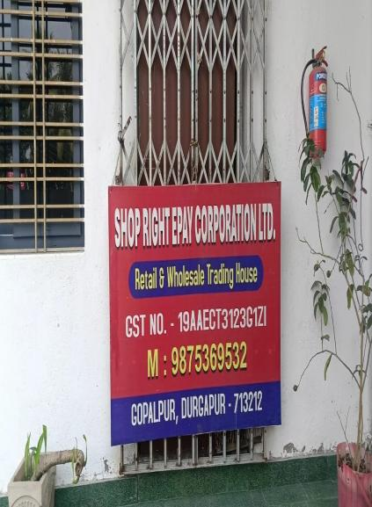


Thank You
LET’S CONNECT
Visit Us. Stock Up.
Save More.
Whether you’re a household stocking up for the week or a small retailer sourcing wholesale, our doors are open six days a week. Drop in, call, or reach us online.
VISIT
Right Pay Shop, Netaji St, Uttarpara,
Gopalpur, Durgapur, West Bengal — 713212
CALL
+91 98753 69532
EMAIL
support@rightpayshop.com
WEB
rightpayshop.com
FACEBOOK
facebook.com/rightpayshop
SHOP RIGHTEPAY CORPORATION LIMITED · CIN U45400WB2011PLC161876 · GSTIN 19AAECT3123G1ZI

